Slide 1
SIC030 - PPT - SESI ke 12 Sistem Perdagangan Elektronik
Electronic Payment System
M HANIF JUSUF ST MKOM

Slide 2
Learning Objectives
Understand the crucial factors that determine the success of e-payment methods.
Discuss the players and processes involved in using credit cards online.
Discuss the different categories and potential uses of smart cards.

Slide 3
Learning Objectives (cont.)
Discuss various online alternatives to credit card payments and identify under what circumstances they are best used.
Describe the processes and parties involved in e-checking.

Slide 4
Learning Objectives (cont.)
Describe payment methods in B2B EC, including payments for global trade.
Discuss bill presentment and payment.
Describe special payment methods.

Slide 5
LensDoc Organizes Payments Online
LensDoc is an online retailer of contact lenses, sun and magnifying glasses, and dental care and personal care products
Customers pay with a credit card
Credit cards also make it easy for a customer to return an item and receive credit for the return

Slide 6
LensDoc Organizes Payments Online (cont.)
People try contact lenses and return them if they are not satisfied
U.S. regulations prohibit the return of contact lenses that have been used
LensDoc had to discard the lenses and to take a loss

Slide 7
LensDoc Organizes Payments Online (cont.)
The Solution
LensDoc implemented special handling procedures for authorizing online credit card purchases
company manually processes credit card orders
customers must fax a form that includes the cardholder’s address as well as the shipping address

Slide 8
LensDoc Organizes Payments Online (cont.)
The Results
Manual processing of credit card payments is slow and solves some problems
However, the disadvantages of alternative e-payment method seem to outweigh the advantages (cash cards, special card-swiping peripherals, credit card processing services)

Slide 9
LensDoc Organizes Payments Online (cont.)
What we can learn…
The potential for fraud is high when credit cards are used online
Merchants are responsible for fraudulent charges because online credit card purchases are treated as “card-not-present” transactions
By 2002, e-tailers began to view credit card fraud as a solvable problem

Slide 10
Electronic Payments: A Critical Element in EC Support Services
E-payments: payments made online
The overwhelming majority of Web purchases are made with credit cards
This may change in the future

Slide 11
Deficiencies of Credit Card Payments
Many people who will be on the Internet in 2020 have not even had their first Web experience
Many of these users will come from countries outside the United States, where the use of credit cards is not as prevalent
Many users are also likely to be younger and have less access to credit and debit cards
Many purchases they make will be micropayments

Slide 12
Deficiencies of Credit Card Payments (cont.)
95 percent of all e-commerce are B2B transactions
Electronic payments are more likely to involve EFTs or electronic checks
Credit cards cannot be used for large sums of B2B transactions
A large amount of fraud with online credit card shopping occurs that results in chargebacks to the merchants

Slide 13
Electronic Payments (cont.)
Chargeback problem—a chargeback means that the customer refuses to pay, claiming that the purchase was made by someone else
Happens in Internet transactions:
Four times more frequently than catalog sales
Nine times more frequently than in brick-and-mortar sales

Slide 14
Electronic Payments (cont.)
“Best practices” used by merchants when conducting credit card transactions:
implementing a firewall
using encryption and antivirus software
incorporating intercompany security practices

Slide 15
Electronic Payments: Best Practices (cont.)
However, since 2002, e-tailers see credit card fraud as a solvable problem
Risk management techniques and fraud-prevention software are widely available
The Merchant Fraud Squad provides education about fraud prevention techniques and encourages businesses selling online to adopt best practices and antifraud technologies

Slide 16
Electronic Payments (cont.)
nochargeback.com and combatfraud.org offer fraud-protection services
Members access the site’s database of credit card numbers, e-mail addresses, and postal addresses used for purchases that resulted in a chargeback
Merchants check for “deadbeats” at this site and then refuse to accept charges from them

Slide 17
Electronic Payment Methods
Electronic payment cards (credit, debit, charge)
Virtual credit cards
E-wallets (or e-purses)
Smart cards
Electronic cash (several variations)

Slide 18
Electronic Payment Methods (cont.)
Wireless payments
Stored-value card payments
Loyalty cards
Person-to-person payment methods
Payments made electronically at kiosks

Slide 19
Electronic Payment Methods (cont.)
E-payments for B2B
Electronic checks
Purchasing cards
Electronic letters of credit
Electronic funds transfer (EFT)
Electronic benefits transfer (EBT) Other innovative methods, including e-lines of credit

Slide 20
Electronic Payment Methods (cont.)
Five parties involved in e-payments:
Customer/payer/buyer
Merchant/payee/seller
Issuer
Regulator
Automated Clearing House (ACH)

Slide 21
Electronic Payments Methods (cont.)
Automated Clearing House (ACH): Electronic network that connects all U.S. financial institutions for the purpose of making funds transfers

Slide 22
Electronic Payments Methods (cont.)
Characteristics of successful
e-payment methods
Independence
Interoperability and portability
Security
Anonymity
Divisibility
Ease of use
Transaction fees
Critical mass

Slide 23
Security for Electronic Payments
Security for e-payments
Standards for e-payments—it is necessary to have generally accepted protocols
SSL (TLS)
SET
SSL
SET

Slide 24
Security for Electronic Payments (cont.)
Other security measures
Both the funds that are being transferred and the consumer data must be protected
intelligent agents
biometrics

Slide 25

Electronic Cards and Smart Cards
Payment card: Electronic card that contains information that can be used for payment purposes
Credit cards
Charge cards
Debit cards

Slide 26
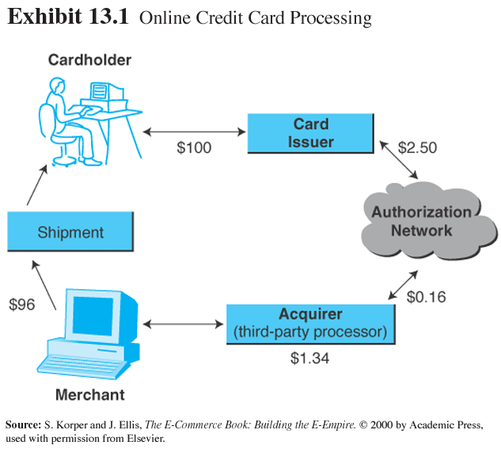
Electronic Cards and Smart Cards (cont.)

Slide 27
Electronic Cards and Smart Cards (cont.)
Card gateway: An online connection that ties a merchant’s systems to the back-end processing systems of the credit card issuer

Slide 28
Electronic Cards and Smart Cards (cont.)
Virtual credit card: An e-payment system in which a credit card issuer gives a special transaction number that can be used online in place of regular credit card numbers
Debit checking accounts—Western Western Union’s MoneyZap service

Slide 29
Electronic Wallets
Electronic wallet (e-wallet): A software component in which a user stores credit card numbers and other personal information; when shopping online, the user simply clicks the e-wallet to automatically fill in information needed to make a purchase

Slide 30
E-Wallets (cont.)
Digital identity (digital ID): A set of digital information that is associated with a particular individual and is used to identify that individual for security purposes

Slide 31
E-Wallets (cont.)
E-wallet as an authenticator
The user contacts the merchant to place an order
The authentication/registry part of the e-wallet generates a pair of keys called session keys

Slide 32
E-Wallets (cont.)
The user decrypts the first session key, using their private key
The merchant decrypts the ticket, using its private key, retrieving the user’s name and the second session key

Slide 33
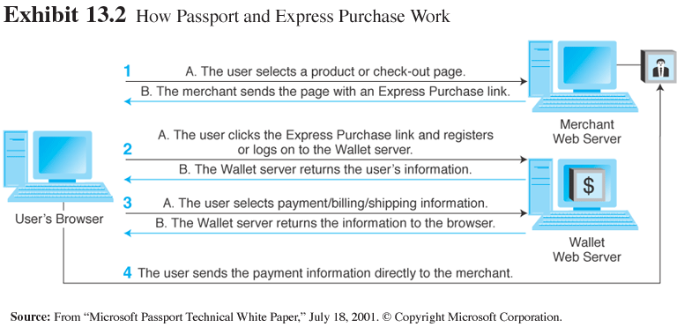
E-Wallets (cont.)

Slide 34
Electronic Cards and Smart Cards (cont.)
Security risks with credit cards
Stolen cards
Reneging by the customer
Theft of card details stored on the merchant’s computer

Slide 35
Electronic Cards and Smart Cards (cont.)
Smart card: An electronic card containing an embedded microchip that enables predefined operations or the addition, deletion, or manipulation of information on the card

Slide 36
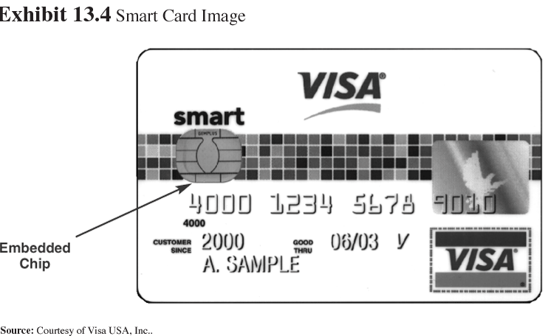
Electronic Cards and Smart Cards (cont.)

Slide 37
Electronic Cards and Smart Cards (cont.)
Contact card: A smart card containing a small gold plate on the face that when inserted in a smart-card reader makes contact and so passes data to and from the embedded microchip

Slide 38
Electronic Cards and Smart Cards (cont.)
Contactless (proximity) card: A smart card with an embedded antenna, by means of which data and applications are passed to and from a card reader unit or other device without contact between the card and the card reader

Slide 39
Electronic Cards and Smart Cards (cont.)
Securing smart cards
Stored-value card: A card that has monetary value loaded onto it, and is usually rechargeable
Some smart cards show account numbers
Most store the information in encrypted form
Cost to the attacker so far exceeds the benefits of hacking into these cards

Slide 40
Electronic Cards and Smart Cards (cont.)
Applications of smart cards
Loyalty cards
Financial applications
Information technology cards
Health and social welfare information cards
Transportation
Identification

Slide 41
Electronic Cards and Smart Cards (cont.)
Multipurpose cards
February 2001, MasterCard International and Korea’s Kookmin Card Corp. issued the first multipurpose smart card in the world
It contains credit and debit card features, e-cash (from Mondex), and public transportation fares

Slide 42
E-Cash and Innovative Payment Systems
E-cash: The digital equivalent of paper currency and coins, which enables secure and anonymous purchase of low-priced items
Inconvenience of opening an account and downloading software and the difficulty of obtaining a critical mass of users seems to have outweighed the benefits

Slide 43
E-Cash and Innovative Payment Systems (cont.)
E-cash alternatives to credit cards for Micropayments: Small payments, usually under $10
Vodafone’s “m-pay bill” system
Qpass

Slide 44
E-Cash and Innovative Payment Systems (cont.)
Stored-value cards and other innovations
Visa Cash: A stored-value card designed to handle small purchases or micropayments; sponsored by Visa
Visa Bucks: prepaid card designed for teens

Slide 45
E-Cash and Innovative Payment Systems (cont.)
Mondex: A stored-value card designed to handle small purchases or micropayments; sponsored by Mondex, a subsidiary of MasterCard
Campus cards: money value is not stored on the card, but in an account equivalent to the card’s ID number

Slide 46
E-Cash and Innovative Payment Systems (cont.)
E-loyalty and rewards programs:
Electronic script: A form of electronic money (or points), issued by a third party as part of a loyalty program; can be used by consumers to make purchases at participating stores
MyPoints-CyberGold (mypoints.com)

Slide 47
E-Cash and Innovative Payment Systems (cont.)
Prepaid stored-value cards
The customer has a prepaid stored-value card, they are more likely to be loyal to the card sponsor, at least until the stored value runs out
Telephone cards
Starbuck’s
RocketCash (rocketcash.com) combines an online cash account with a rewards program

Slide 48
E-Cash and Innovative Payment Systems (cont.)
Person-to-person (P2P) payments: E-payment schemes (such as PayPal) that enable the transfer of funds between two individuals
PayPal (paypal.com)
Citibank c2it (c2it.com)
AOL QuickCash (aol.com)
Bank One’s eMoneyMail (bankone.com/presents/emoneymail/home/)
Yahoo PayDirect (paydirect.yahoo.com)
WebCertificate (webcertificate.com)

Slide 49
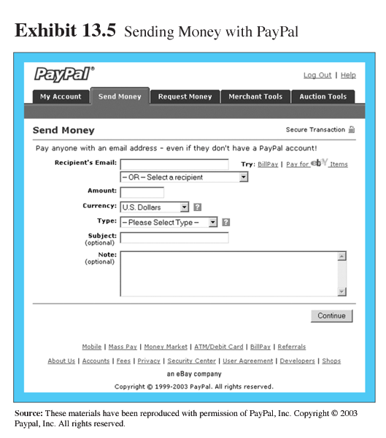
E-Cash and Innovative Payment Systems (cont.)

Slide 50
E-Cash and Innovative Payment Systems (cont.)
Non-Internet EC payments
Check yourself out—consumers can use kiosks to check out (Sears, Kmart, Home Depot)
Buying from vending machines—use regular credit cards at PepsiCo and Coca-Cola vending machines
Paying with a check without writing it—check is scanned, customer’s bank account is debited, the merchant account is credited (Wal-Mart, Costco)

Slide 51
E-Checking
E-check: The electronic version or representation of a paper check
Eliminate the need for expensive process reengineering and taking advantage of the banking industry
Can be used by all bank customers who have checking accounts

Slide 52
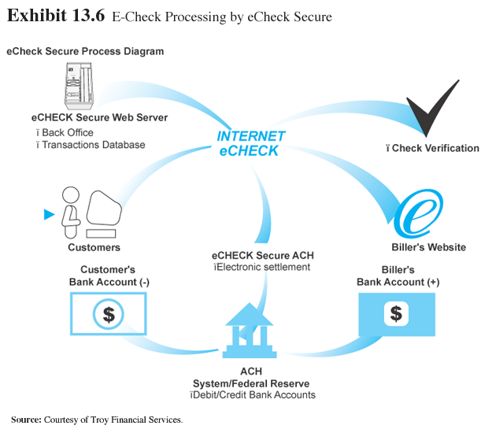
E-Checking (cont.)

Slide 53
B2B Electronic Payments
Financial supply chains (FSC)
FSC parallels the physical supply chain
Follows a buyer’s transaction activities related to cash flow, which start with a purchase order and end in settlement with the seller

Slide 54
B2B Electronic Payments (cont.)
Typical segments of the FCS:
Segment 1: Examination of catalogs, electronic order entry
Segment 2: Online negotiations, culminating in a preliminary agreement
Segment 3: Credit check, seller validation, payment assurance, financing

Slide 55
B2B Electronic Payments (cont.)
Segment 4: Invoice presentment, verification of delivery, “trade service” quote, and booking
Segment 5: Data matching, discrepancy resolution, final payment calculation, buyer approval, currency exchange calculation (if needed), and arrangements for automatic payment
Segment 6: Payment instructions, money transfer, debit and credit notices

Slide 56
B2B Electronic Payments (cont.)
B2B payment solutions
Purchasing cards: Special-purpose payment cards issued to a company’s employees to be used solely for purchasing nonstrategic materials and services up to a preset dollar limit

Slide 57
B2B Electronic Payments (cont.)
Benefits accrued from the use of purchasing cards
Productivity gains
Purchasing departments freed from day-to-day procurement activities; focus on relationships with suppliers
Bill consolidation
Consolidated into a single invoice that can be paid electronically through EDI or EFT

Slide 58
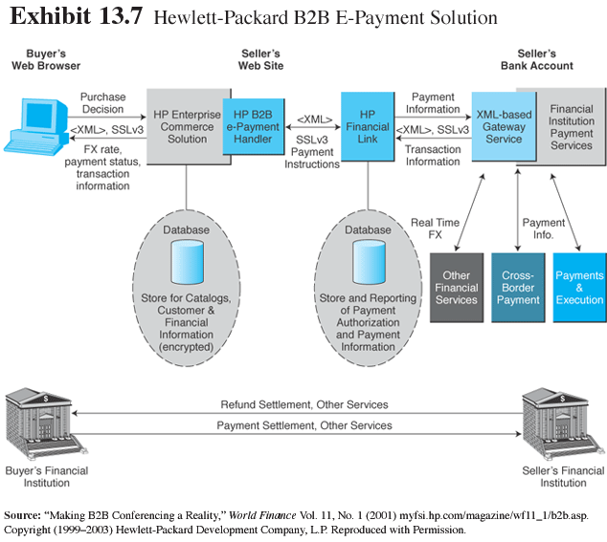
B2B Electronic Payments (cont.)

Slide 59
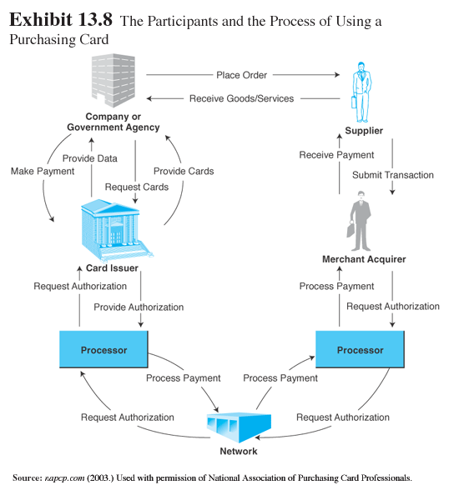
B2B Electronic Payments (cont.)

Slide 60
B2B Electronic Payments (cont.)
Benefits to the buyers, agency where they work, and the merchant
Payment reconciliation
Expedited payments
Management reports
Control

Slide 61
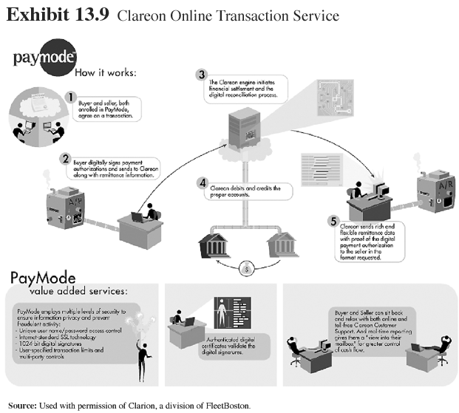
B2B Electronic Payments (cont.)

Slide 62
B2B Electronic Payments (cont.)
Global B2B payments
Letter of credit (LC): A written agreement by a bank to pay the seller, on account of the buyer, a sum of money upon presentation of certain documents

Slide 63
B2B Electronic Payments (cont.)
Benefits of LCs to the seller
payment is highly assured if all the terms and conditions stipulated are met
credit risk is reduced
political/country risk is reduced when confirmed by a bank in the seller’s country

Slide 64
B2B Electronic Payments (cont.)
Benefits of LCs to the buyer
allows the buyer to negotiate for a lower purchase
buyer may expand its sources of supply and bargaining power
funds withdrawn from the buyer’s account only after the documents have been inspected giving the buyer a bit more time to hold its money

Slide 65
B2B Electronic Payments (cont.)
Tradecard payments in B2B global tracing
Members of Tradecard interact with each other via the TradeCard system
checks purchase orders for both parties
waits for a confirmation from a logistics company that deliveries have been made and received
authorizes payment to complete the financial transaction between the buyer and seller

Slide 66
Electronic Bill Presentment and Payment
E-billing
Presentment: The presentation and hosting on a specialized Web server of information that is typically printed on a bill
Two models of presentment
common-biller direct
third-party consolidators

Slide 67
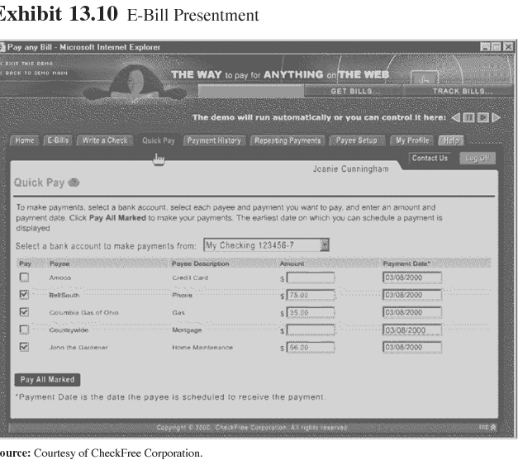
Electronic Bill Presentment and Payment (cont.)

Slide 68
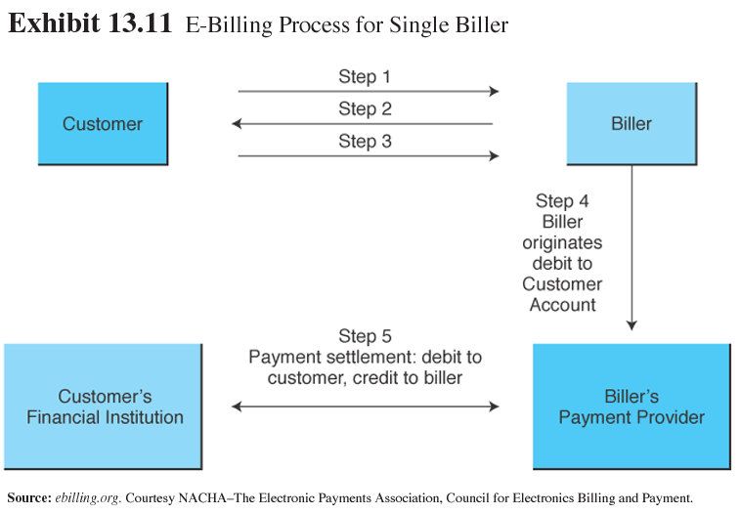
Electronic Bill Presentment and Payment (cont.)

Slide 69
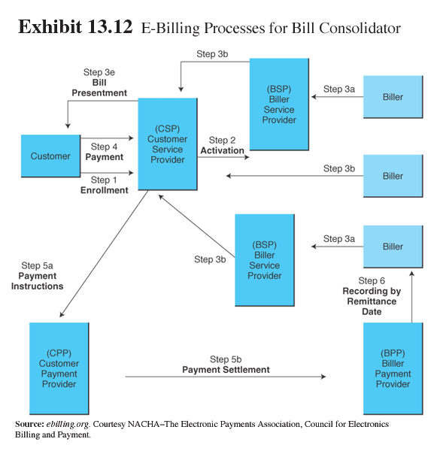
Electronic Bill Presentment and Payment (cont.)

Slide 70
Electronic Bill Presentment and Payment (cont.)
Paying bills at ATMs
Customer receives the bill
Go to any ATM, slide in their bank card, enter a password, and go to “bill payments” on the menu
Insert the account number of the biller and the amount to be paid
Customer gets a printed receipt showing that the payment has been made

Slide 71
Electronic Bill Presentment and Payment (cont.)
Advantages of e-billing
For the billing firm:
Reduction in expenses
Enables better customer service
Electronic ad inserts can be customized

Slide 72
Electronic Bill Presentment and Payment (cont.)
Advantages of e-billing
For the customer:
Reduces customer’s expenses
Simplifies and centralizes payment processing and provides better record keeping
Customers review and pay bills at virtually any time, giving them direct control over the timing of the payment

Slide 73
Electronic Bill Presentment and Payment (cont.)
Checkfree (checkfree.com) leading third-party e-billing vendor
Consolidates and aggregates all of a customer’s bills into a single presentment
Set up payments with companies that do not offer electronic billing
Alerts users to problems with any payments
Users can export the transaction records to Quicken or Microsoft Money

Slide 74
Payment-Related Issues
Tax calculation services for businesses
DPC (salestax.com) licenses software that makes it simple to collect and report sales taxes

Slide 75
Tax-Related Issues
Sales Tax Clearinghouse (STC) has a free online sales tax calculator for the U.S. and Canada (thestc.com/ratecalc.stm)

Slide 76
Tax-Related Issues (cont.)
Taxware International (taxware.com) produces software that operates seamlessly with leading financial and accounting packages on multiple hardware platforms to accurately automate tax compliance

Slide 77
Tax-Related Issues (cont.)
Implementing tax collection in the U.S.
Streamlined Sales Tax Project (SSTP)— designed to create uniformity in the way states administer sales and use taxes
Merchants use the Internet to send sales transaction data in real time to any participating system

Slide 78
Tax-Related Issues (cont.)
How the systems works
A consumer initiates an online purchase
The e-business uses the Internet to access a trusted third-party tax service provider
The provider calculates the tax on the purchase based on
the locations of the buyer and the seller
applicable state and local tax laws

Slide 79
Tax-Related Issues (cont.)
The third party makes a single monthly or quarterly tax payment to each relevant government tax authority
The tax authority then securely accesses a database, managed by the third party over the Web, to examine the transaction data for tax compliance

Slide 80
Special Payment-Related Issues (cont.)
Cybersource: a comprehensive payment provider; services include:
Electronic payments
Credit card fraud management
Verification and compliance services

Slide 81
Special Payment-Related Issues (cont.)
Financial services for B2B
Credit reporting
Risk analysis and financial matching
Exchange insurance

Slide 82
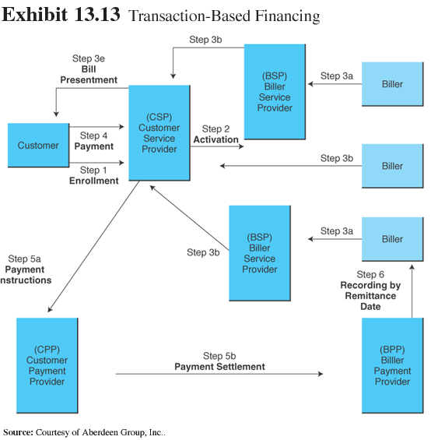
Special Payment-Related Issues (cont.)

Slide 83
Managerial Issues
What B2C payment methods should we use?
What B2B payment methods should we use?
Should we use an in-house payment mechanism or oursource?
How secure are e-payments?

Slide 84
Summary
Crucial factors determining the success of an e-payment method.
Online credit card players and processes.
Categories and potential uses of smart cards.
Online alternatives to credit card payments.

Slide 85
Summary (cont.)
E-check processes and involved parties.
Payment methods in B2B, including global trade.
Bill presentment and payment.
Special payment methods.

Slide 86

Selesai

